Slide 1

Ruby on Rails

Slide 2
About today…
Ruby on Rails
ActiveRecord
CRUD using ActiveRecord

Slide 3
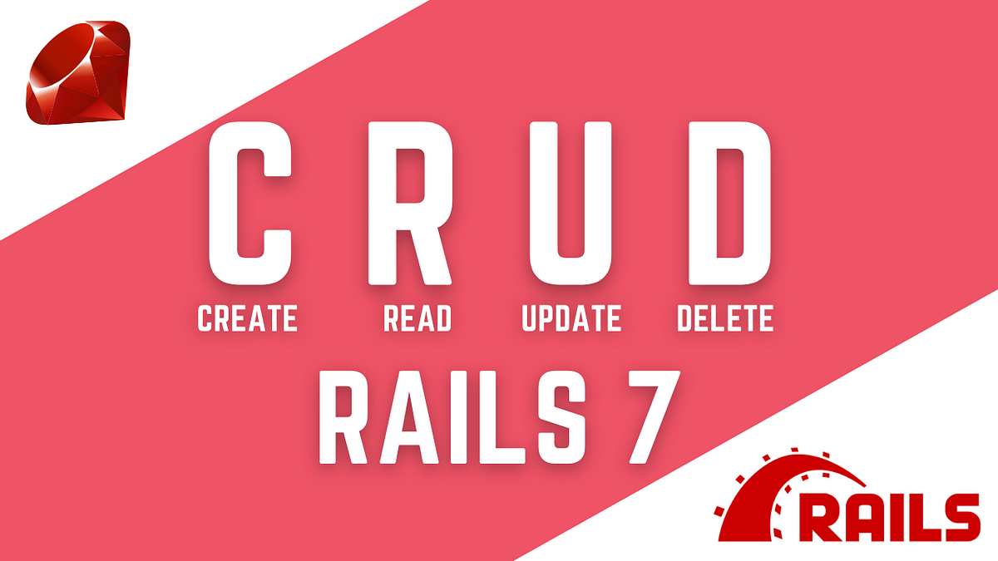
Using ActiveRecord

Slide 4





Introduction to CRUD with ActiveRecord

Slide 5
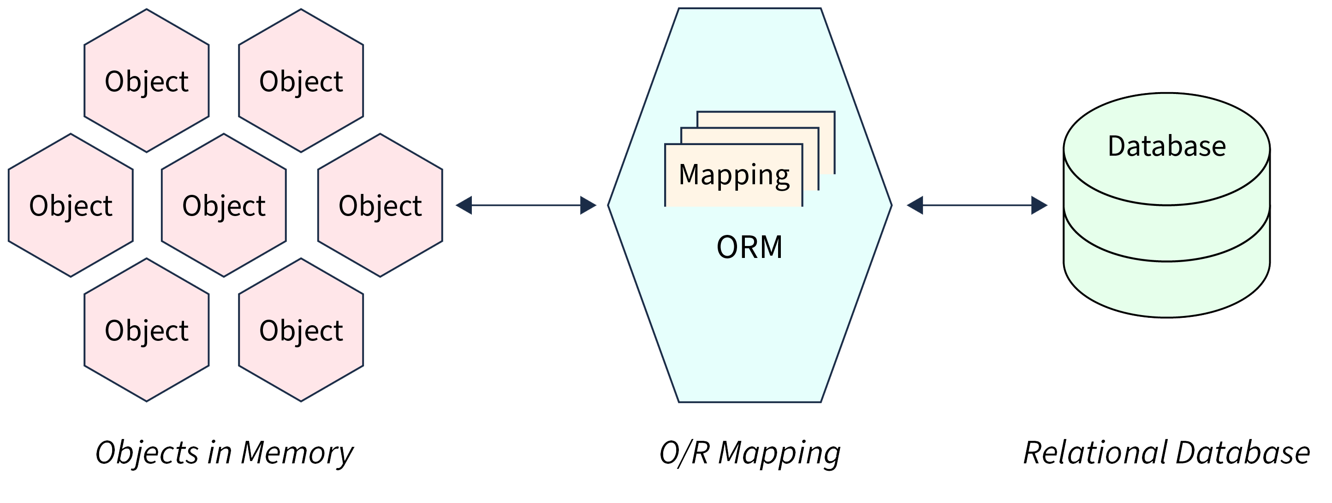
ActiveRecord Overview
Object-Relational Mapping (ORM) in Rails
Maps database tables to Ruby classes

Slide 6


Start ActiveRecord

Slide 7


Slide 8
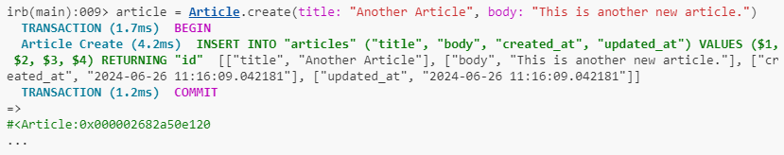
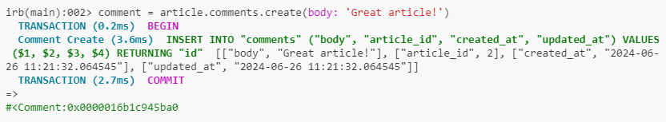
Insert

Slide 9


Slide 10


Read all

Slide 11
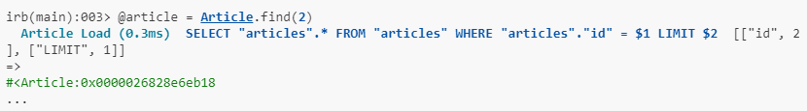
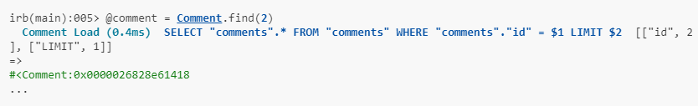
Read one

Slide 12
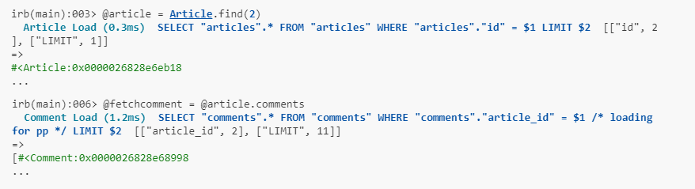
Read one on the base of other fetched

Slide 13


Slide 14
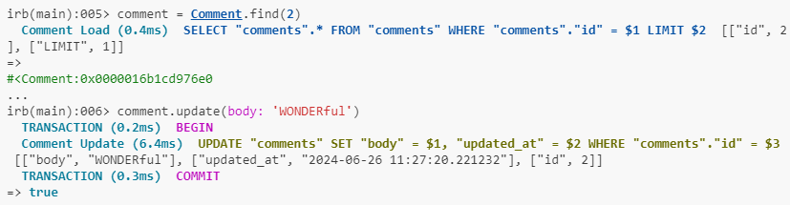
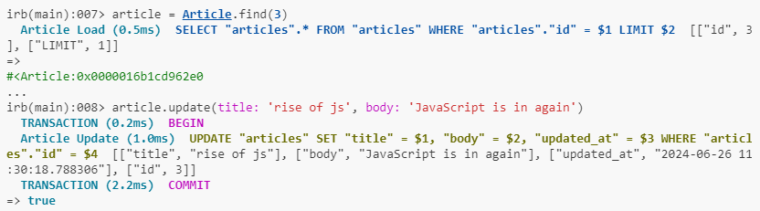

Slide 15


Slide 16
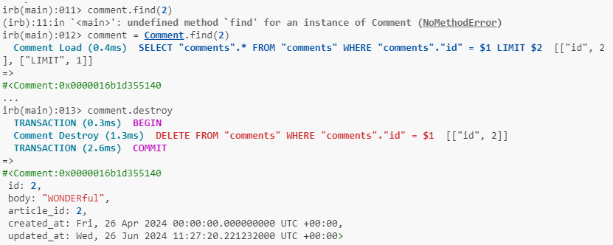

Slide 17
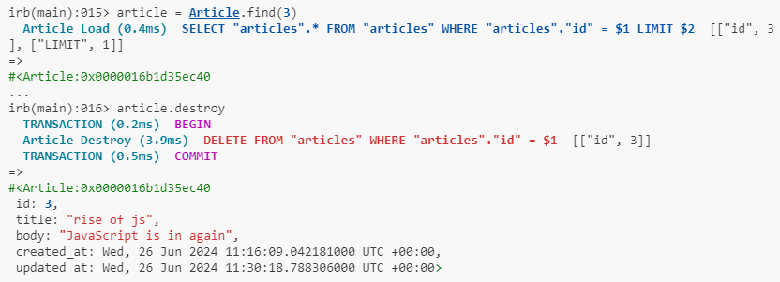

Slide 18


Slide 19

What does CRUD stand for in the context of database operations?
Which command in Rails console is used to create a new record in the database?
Which Rails command is used to delete a record from the database?
How do you retrieve all records from a table in Rails console?
What Rails method is commonly used to update attributes of an existing record?

Slide 20

Task 1
Use Rails console to create a new entry in a table of your choice. Populate it with relevant data
Task 2
Select a record from a table and update one of its attributes (e.g., change the email address).

